Slide 1



Efficiently Modeling Long Sequences with Structured State Spaces
Albert Gu, Karan Goel, and Christopher Re
Department of Computer Science, Stanford University
Shen Yuan
2023-7-19

Slide 2
Outline
Introduction
State space models (SSM) for deep sequence modeling
Structured state spaces (S4) for long-term dependencies
Experiments
Conclusion

Slide 3
Introduction
State space models (SSM) for deep sequence modeling
Structured state spaces (S4) for long-term dependencies
Experiments
Conclusion

Slide 4
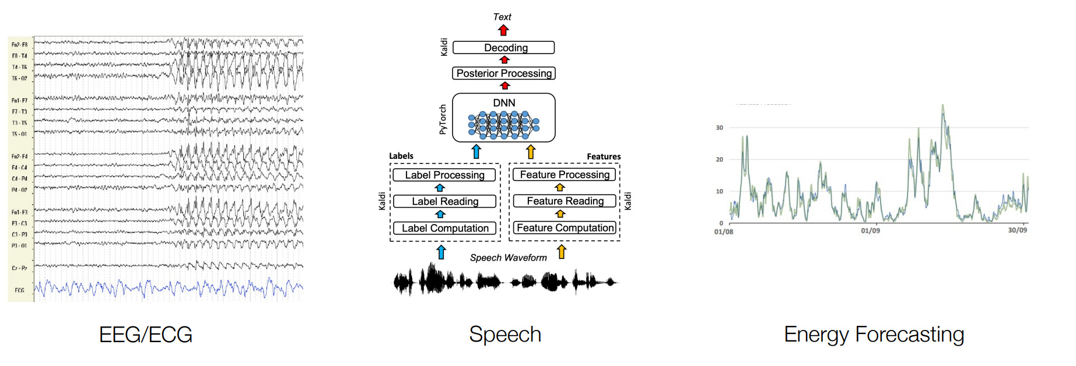
Long "Continuous" Time Series
Time series sampled from an underlying (continuous) physical process

Slide 5
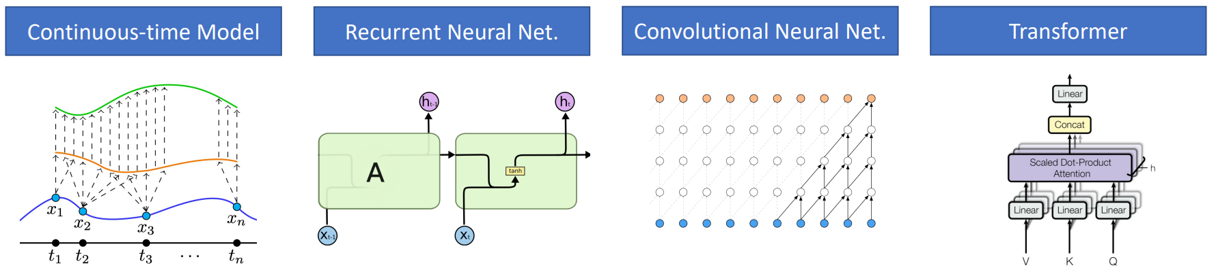
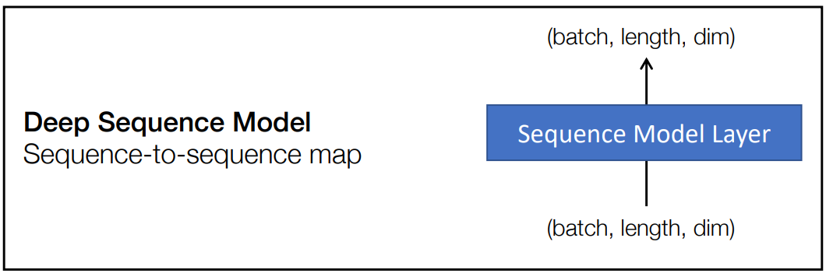
Sequence Modeling Paradigms

Slide 6
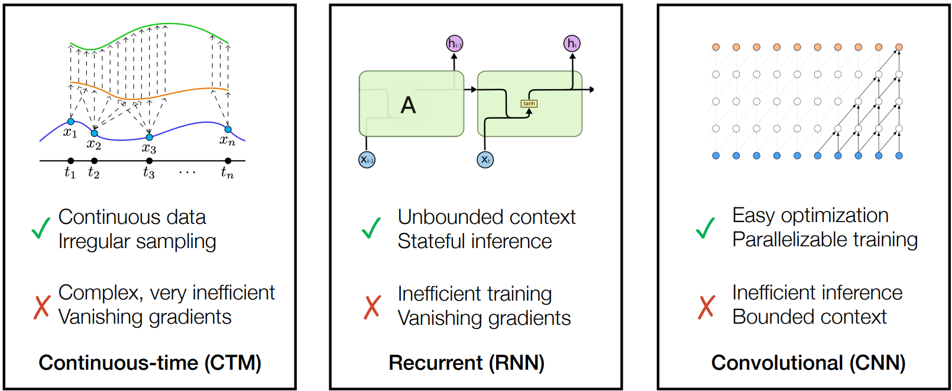
Paradigms for Long Time Series
Existing model families have clear tradeoffs
All struggle with long-range dependencies (LRD)

Slide 7
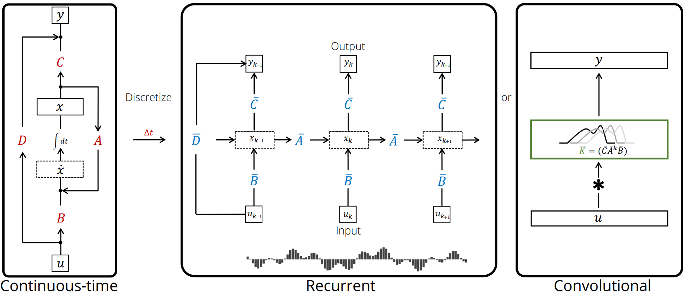
Structured State Spaces (S4)

Slide 8
Introduction
State space models (SSM) for deep sequence modeling
Structured state spaces (S4) for long-term dependencies
Experiments
Conclusion

Slide 9
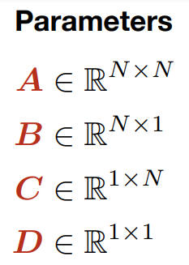
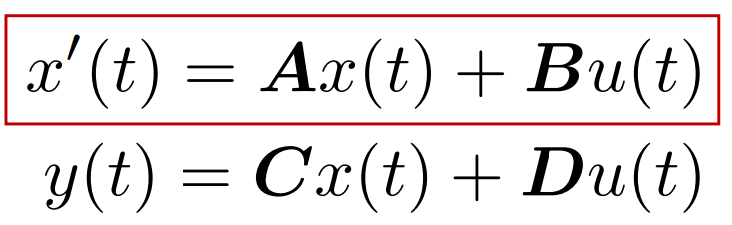

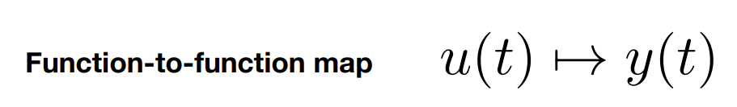
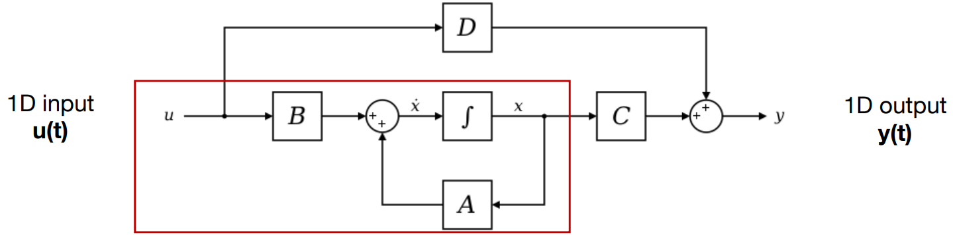
Computing with SSMs: Continuous View

Slide 10
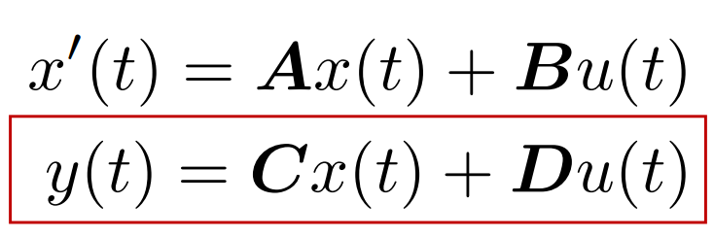

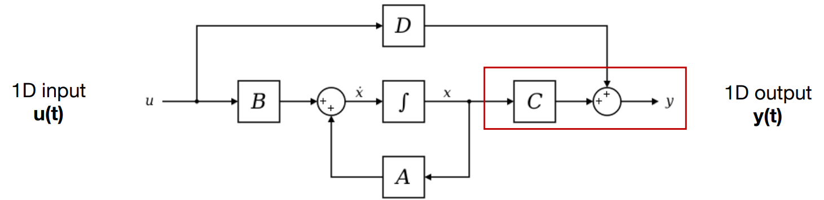
Computing with SSMs: Continuous View

Slide 11
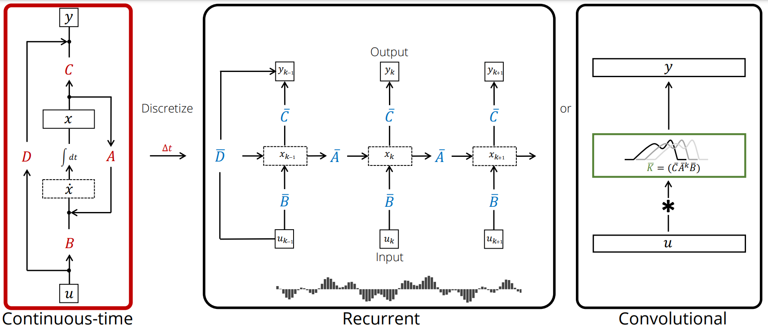
SSM: Continuous Representation

Slide 12
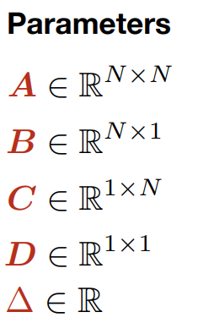




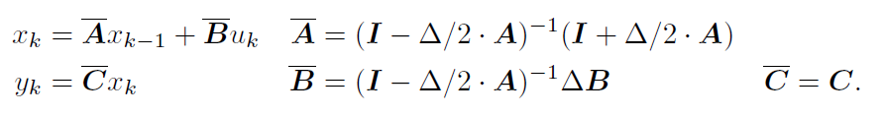
Computing with SSMs: Recurrent View
Conceptually, the inputs can be viewed as sampling an implicit underlying continuous signal u(t), where .
To discretize the continuous-time SSM, we follow prior work in using the bilinear method, which converts the state matrix into an approximation . The discrete SSM is
Now it’s a sequence-to-sequence map instead of function-to-function map.

Slide 13
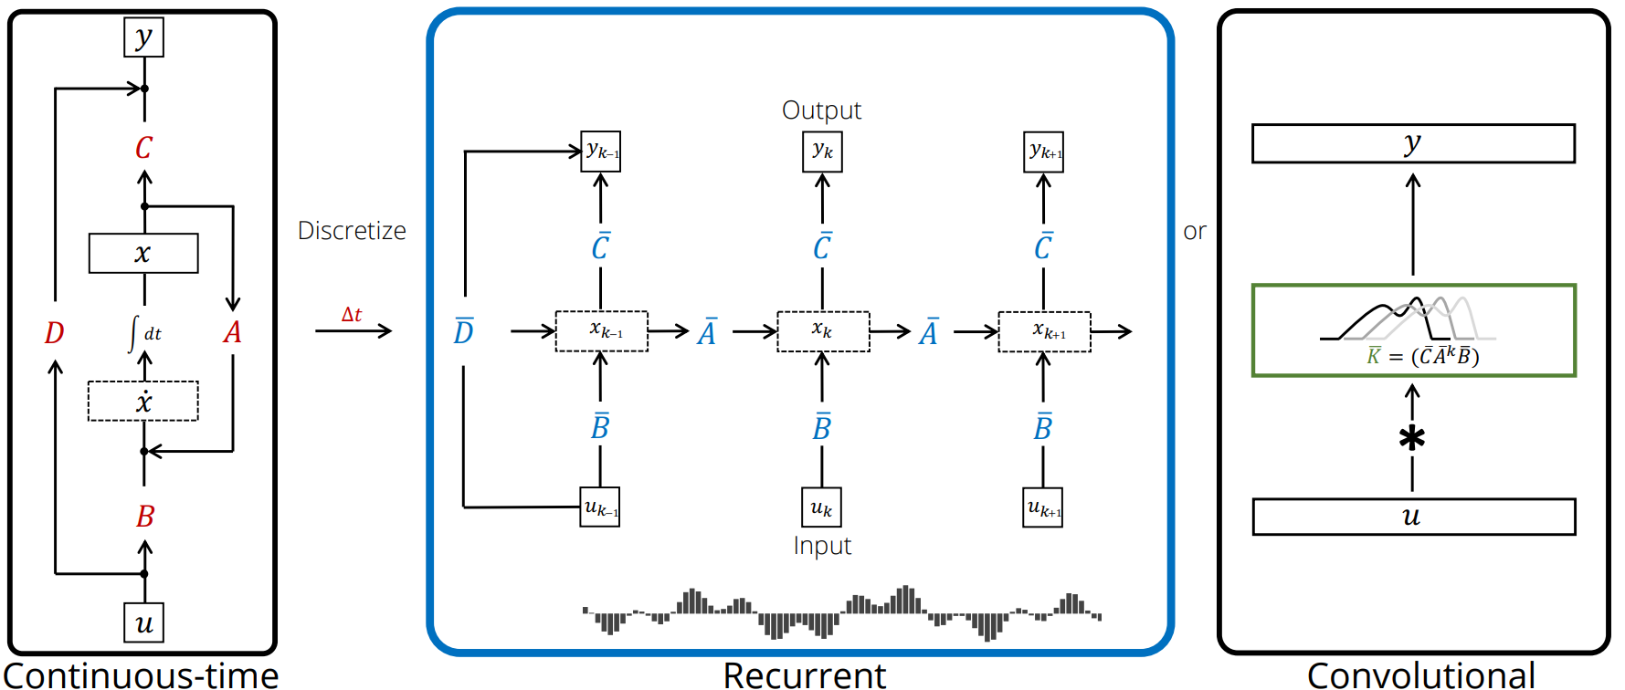
SSM: Recurrent Representation

Slide 14
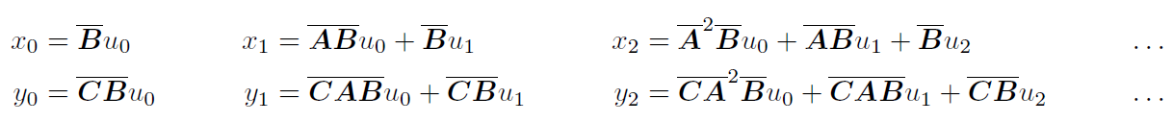
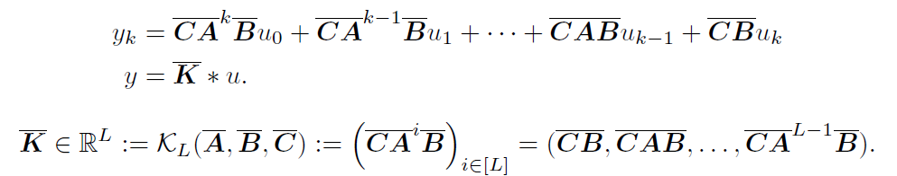
Computing with SSMs: Convolutional View
This can be vectorized into a convolution with an explicit formula for the convolution kernel:

Slide 15
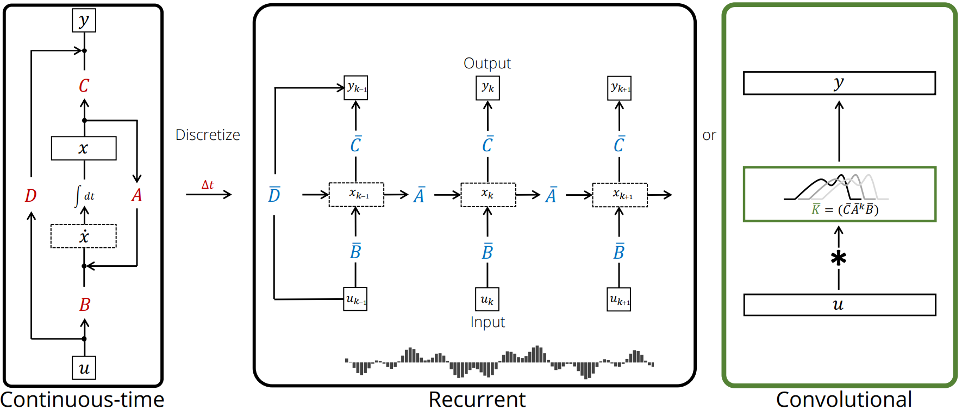
SSM: Convolutional Representation

Slide 16
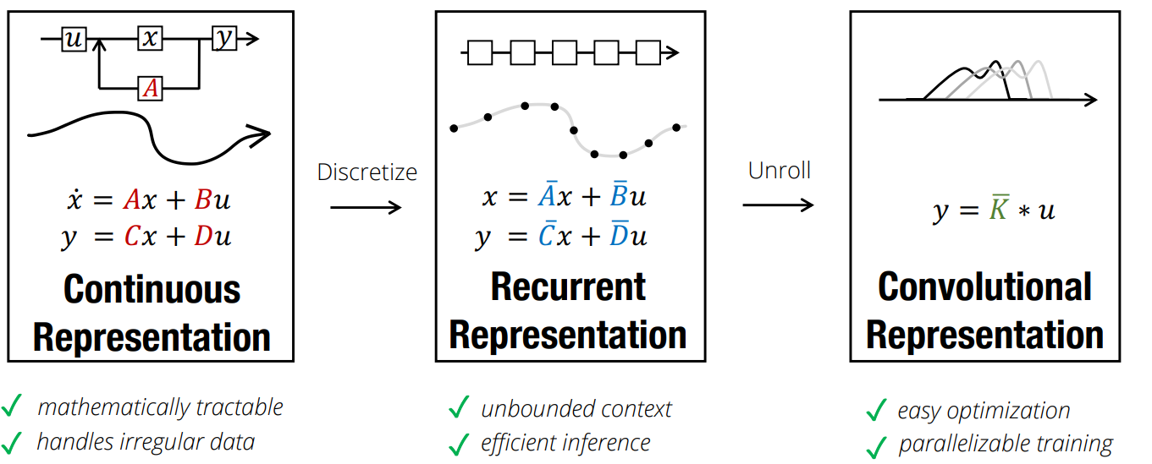
Summary: Properties of SSMs
Simple & principled... why haven't SSMs been used in deep learning?

Slide 17
Introduction
State space models (SSM) for deep sequence modeling
Structured state spaces (S4) for long-term dependencies
Experiments
Conclusion

Slide 18
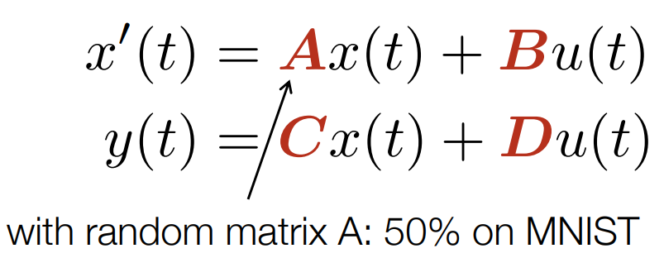
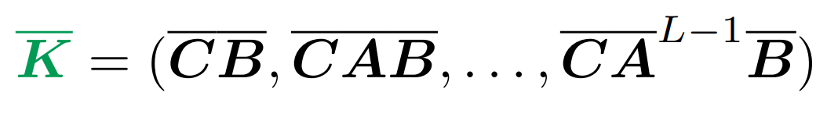
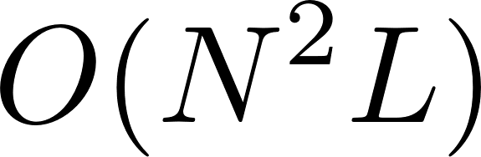

Challenges of Deep SSMs
Modeling Challenge: SSMs inherit properties of CTMs, RNNs, CNNs... including problems with LRDs
Powering up → vanishing gradients?
Powering up → computation complexity
Computation Challenge: SSMs have nice properties provided that representations and are known, but computing them is extremely hard!

Slide 19
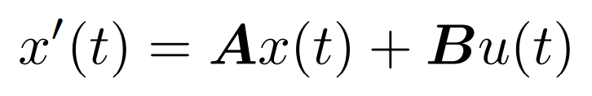


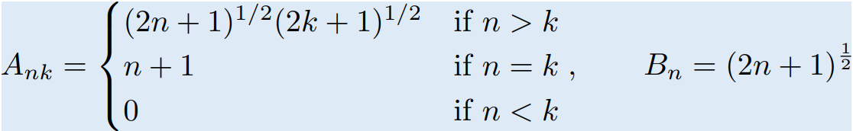
Addressing Long-Range Dependencies with HiPPO Matrix
HiPPO specifies a class of certain matrices that when incorporated into (1), allows the state x(t) to memorize the history of the input u(t).
G.*, Dao*, Ermon, Rudra, Ré. "HiPPO: Recurrent Memory with Optimal Polynomial Projections." NeurIPS 2020
G., Johnson, Goel, Saab, Dao, Rudra, Ré. "Combining Recurrent, Convolutional, and Continuous-time Models with Linear State Space Layers." NeurIPS 2021

Slide 20
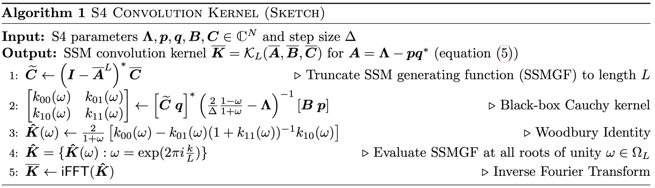
Structured State Spaces (S4)
Computing is non-trivial and is the focus of technical contributions of this paper.

Slide 21
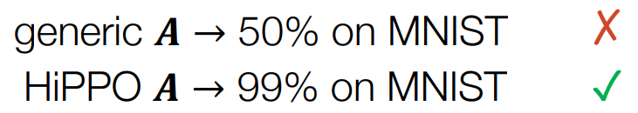
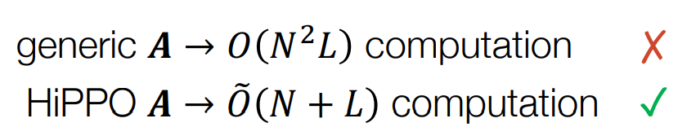
Challenges of Deep SSMs
Modeling Challenge: SSMs inherit properties of CTMs, RNNs, CNNs... including problems with LRDs
Computation Challenge: SSMs have nice properties provided that representations and are known, but computing them is extremely hard!

Slide 22
Introduction
State space models (SSM) for deep sequence modeling
Structured state spaces (S4) for long-term dependencies
Experiments
Conclusion

Slide 23
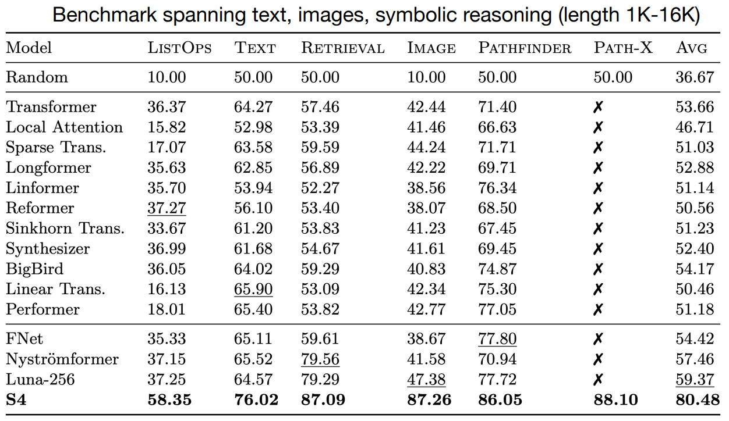
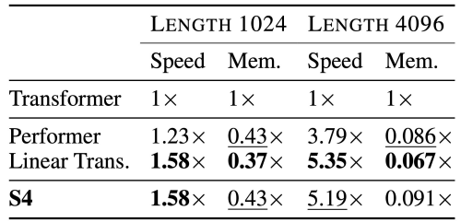
Long Range Arena

Slide 24
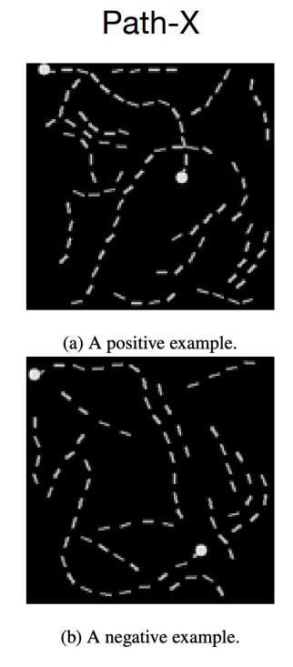
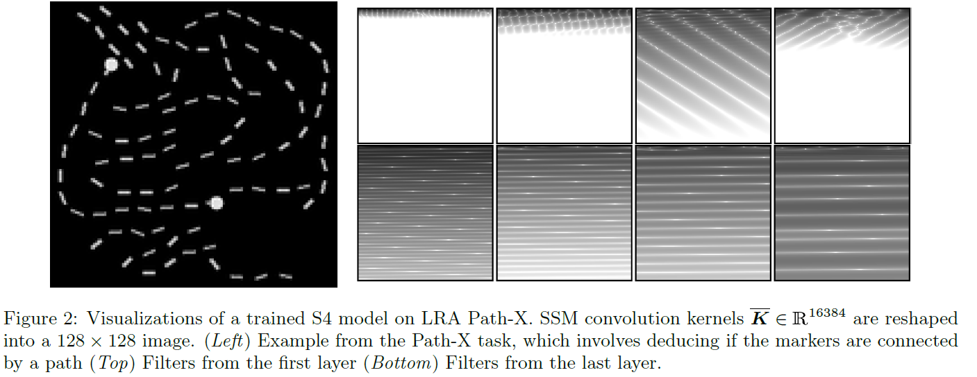
Long Range Arena Path-X

Slide 25
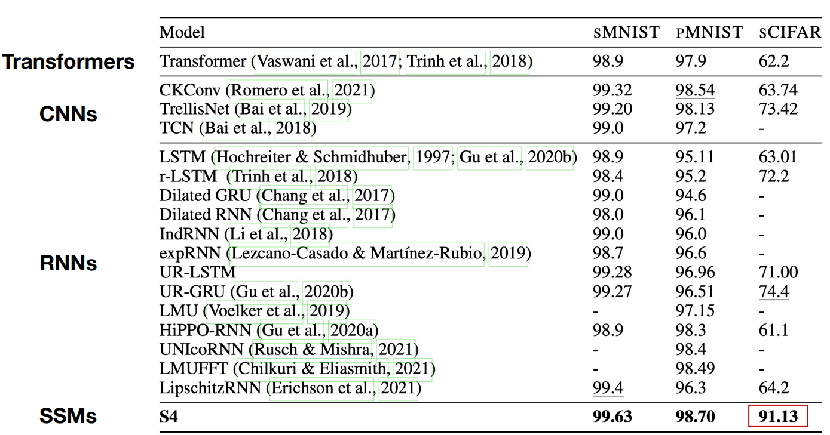
Sequential Image Classification

Slide 26
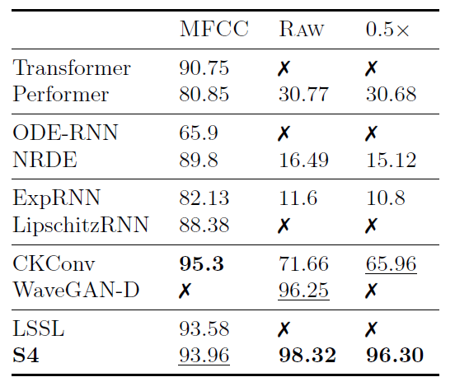
Speech Classification(keywords spotting)
L=160
L=16K
L=8K
Speech is difficult because LRD:
1 second clip = length-16000
Mel-frequency Cepstrum Coefficients (MFCC) (length 160)

Slide 27
Introduction
State space models (SSM) for deep sequence modeling
Structured state spaces (S4) for long-term dependencies
Experiments
Conclusion

Slide 28
Conclusion
This paper proposed a surprising sequence model S4, which can handle LRDs, and move between continuous-time, convolutional, and recurrent model representations, each with distinct capabilities.
This approach enables SSMs to be applied successfully to a varied set of benchmarks with minimal modification.

Slide 29
Thank You for listening!
Shen Yuan
2023-7-19

